Slide 1
Introduction Field Bus (wired) Communication for Embedded System
Vraj Suratwala
Department of ICT, VNSGU

Slide 2
Index
Basic Understaing of SPI
Introduction to I2C
Introduction to UART & USART

Slide 3
1. SPI (serial peripheral interface)
Advance 8051 microcontroller provides another
  high-speed serial communication interface, the
  SPI interface. SPI is a full-duplex, high-speed,
  synchronous communication bus with two
operation modes:
  – Master mode
  – Slave mode.
Up to 3Mbit/s can be supported in either Master or Slave mode.
It has a Transfer Completion Flag and Write Collision Flag Protection.

Slide 4
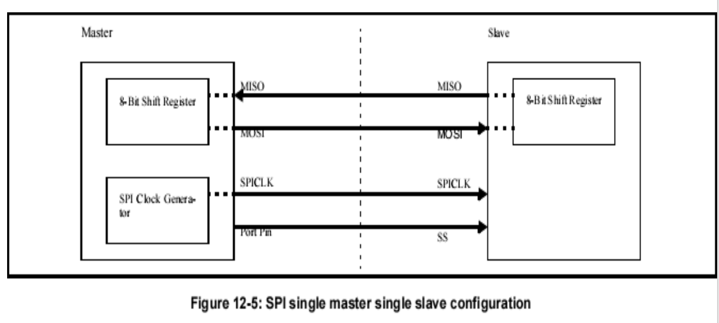
Typical SPI Configuration

Slide 5
Deatils
The SPI interface has four pins:
  SPICLK, MOSI, MISO and SS:
SPICLK, MOSI and MISO are typically tied together between two or more SPI devices.
Data flows from master to slave on the MOSI (Master Out Slave In) pin and flows from slave to master on the MISO (Master In Slave Out) pin.
The SPICLK signal is output in the master mode and is input in the slave mode.If the SPI system is disabled, i.e. SPEN (SPCTL.6) = 0 (reset value), these pins are configured for port functions.
SS is the optional slave select pin.
In a typical configuration, an SPI master asserts one of its port pins to select one SPI device pin to determine whether it is selected.
The SS is ignored if any of the as the current slave.

Slide 6
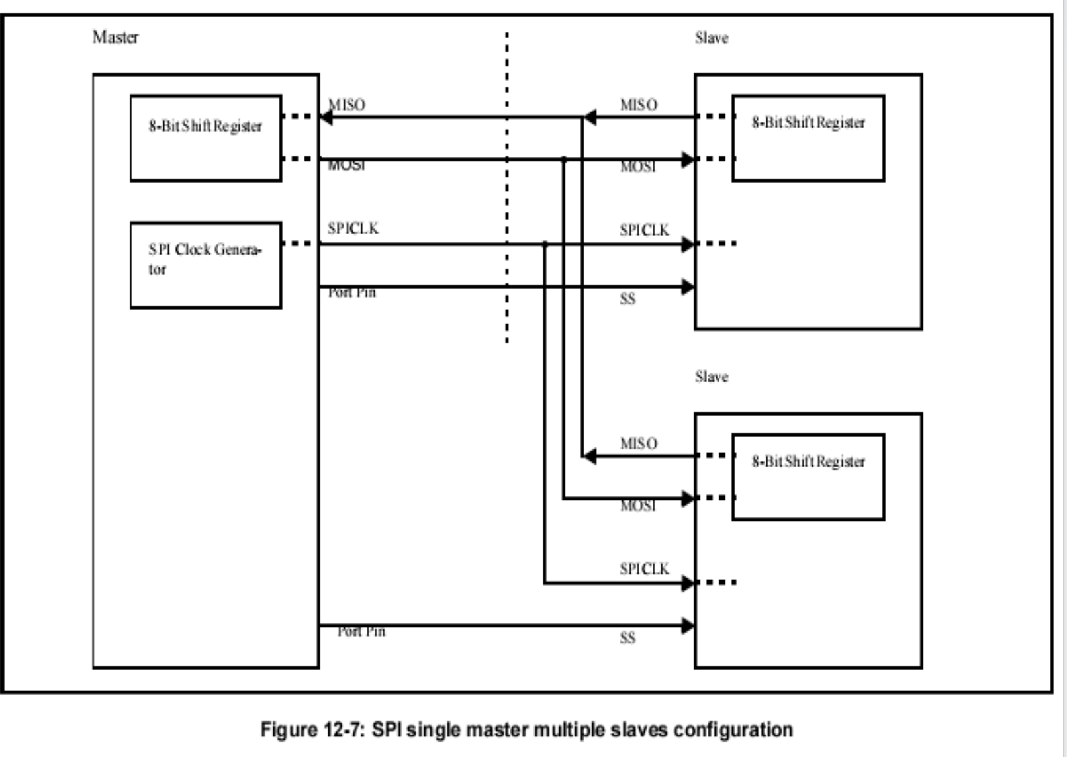
Multiple
Slaves

Slide 7
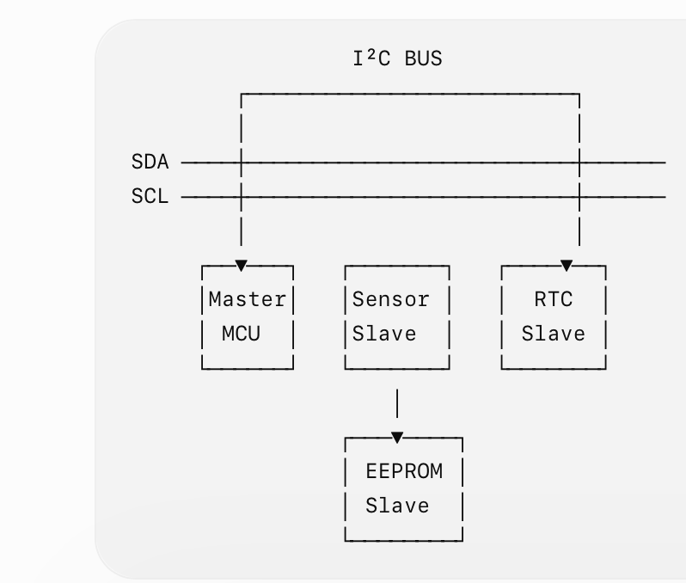
2. I2C
I²C (Inter-Integrated Circuit) is a synchronous serial communication protocol that allows multiple devices to communicate using only two communication lines: SDA and SCL.
Lines
  SDA → Serial Data
  SCL → Serial Clock

Slide 8
I2C Working
The master generates the clock and selects a slave using its address.
Key Points
Only 2 wires are required.
Supports multiple devices.
Uses device addressing.
Synchronous communication.
Commonly used for sensors, RTC, EEPROM, OLED displays, etc.
Master
│
│ START
▼
Slave Address
│
▼
Read / Write
│
▼
Data Transfer
│
▼
STOP

Slide 9
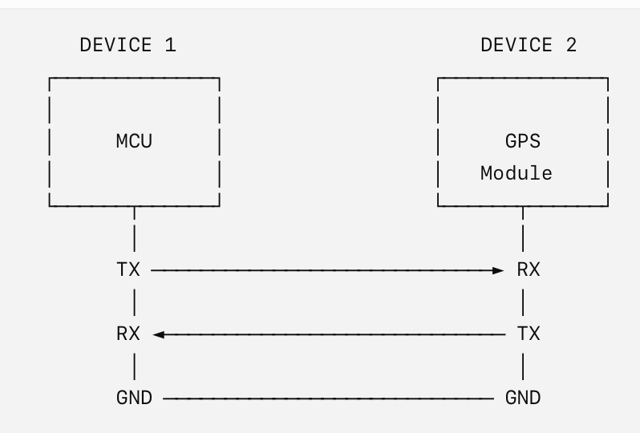
3. UART — Universal Asynchronous Receiver/Transmitter
UART is an asynchronous serial communication interface used for communication between two devices.
Unlike I²C and SPI, UART does not use a separate clock signal.
Important
TX of Device 1 → RX of Device 2
RX of Device 1 ← TX of Device 2

Slide 10
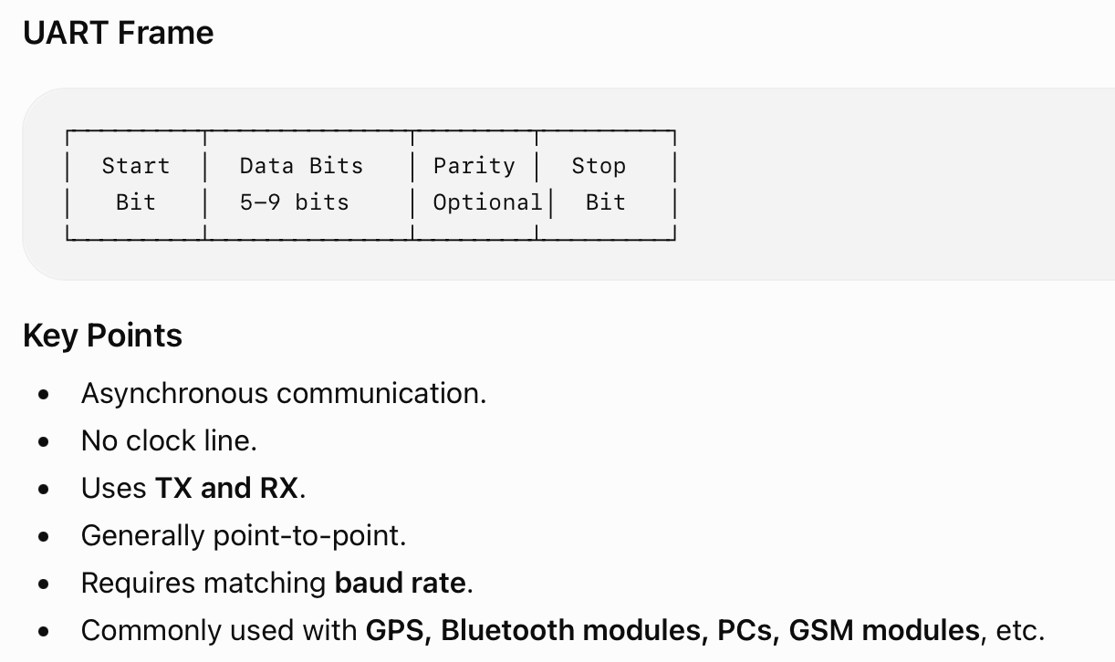

Slide 11
4. USART — Universal Synchronous/Asynchronous Receiver/Transmitter
USART is a serial communication interface capable of operating in both synchronous and asynchronous modes.
Therefore:
USART = UART + Synchronous Communication Capability

Slide 12
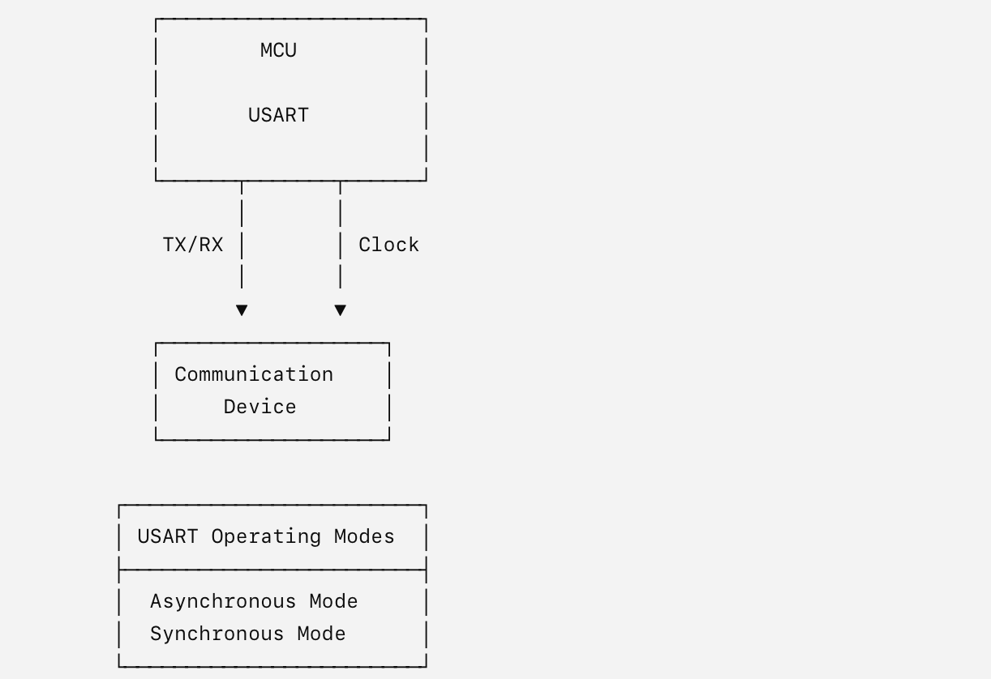
USART Diagram

Slide 13
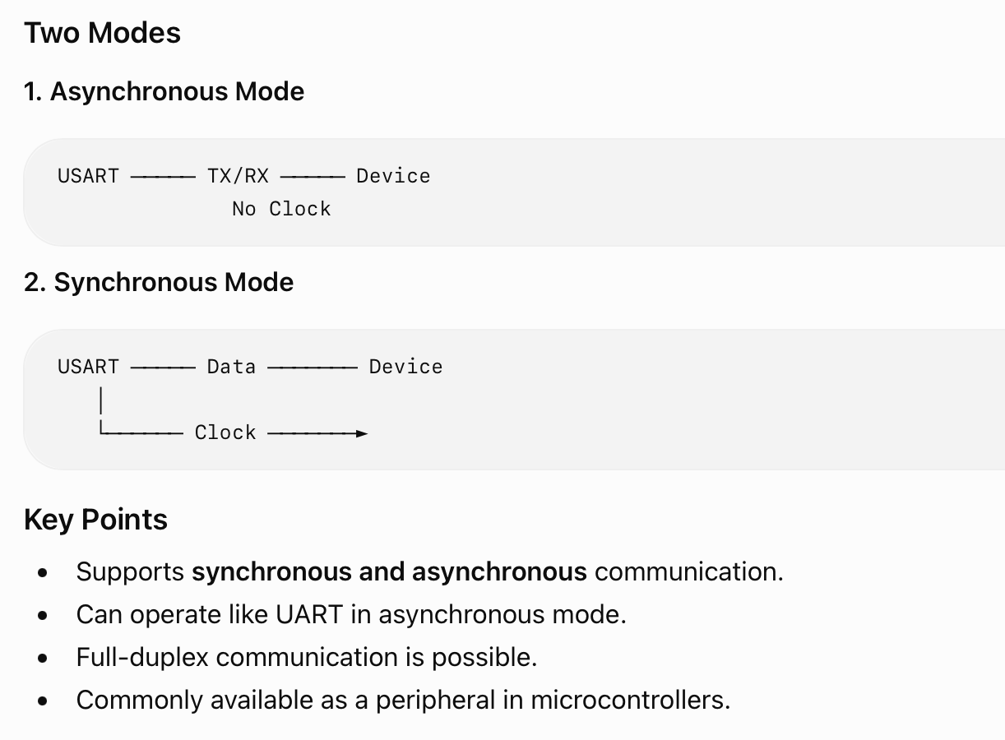

Slide 14
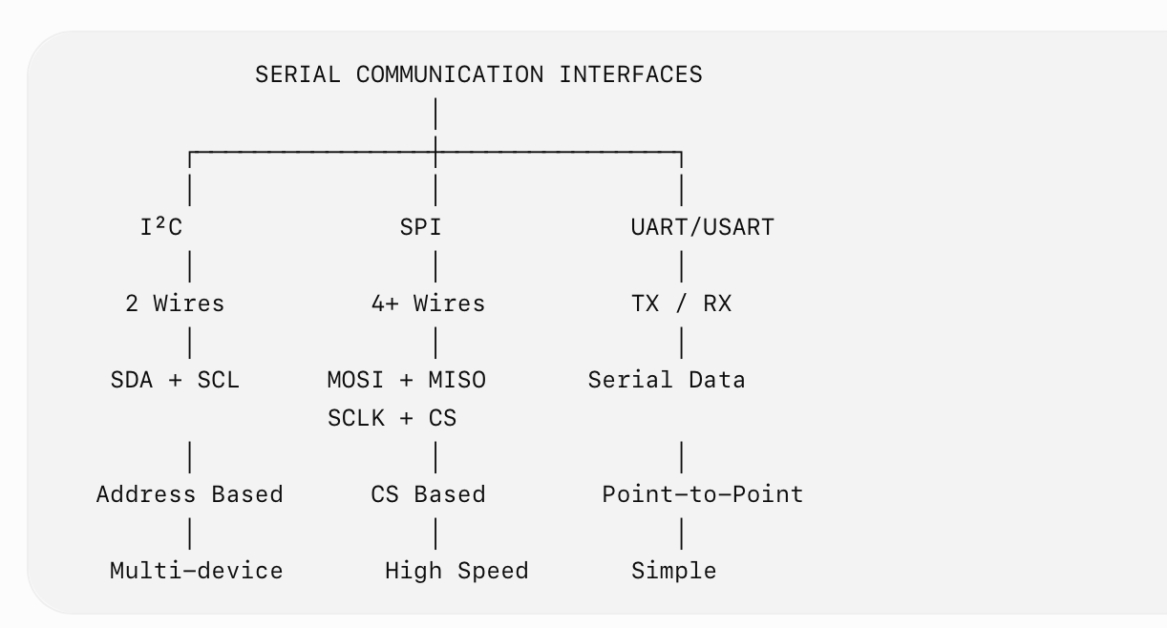
Summary

Slide 15
Thank You
Vraj Suratwala
Department of ICT, VNSGU

